Slide 1


Titolo presentazione sottotitolo
By Yan Zhuang
YASC
Milano, XX mese 20XX

Slide 2
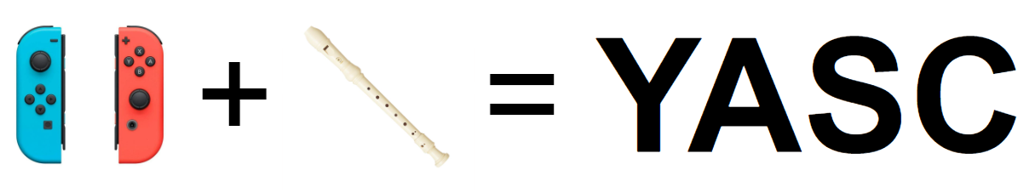
Introduction
The goal of the project is to to develop an interactive recorder performance tool, incorporating Joy-Con controllers via a web interface for gesture-based inputs and SuperCollider for sound synthesis.

Slide 3
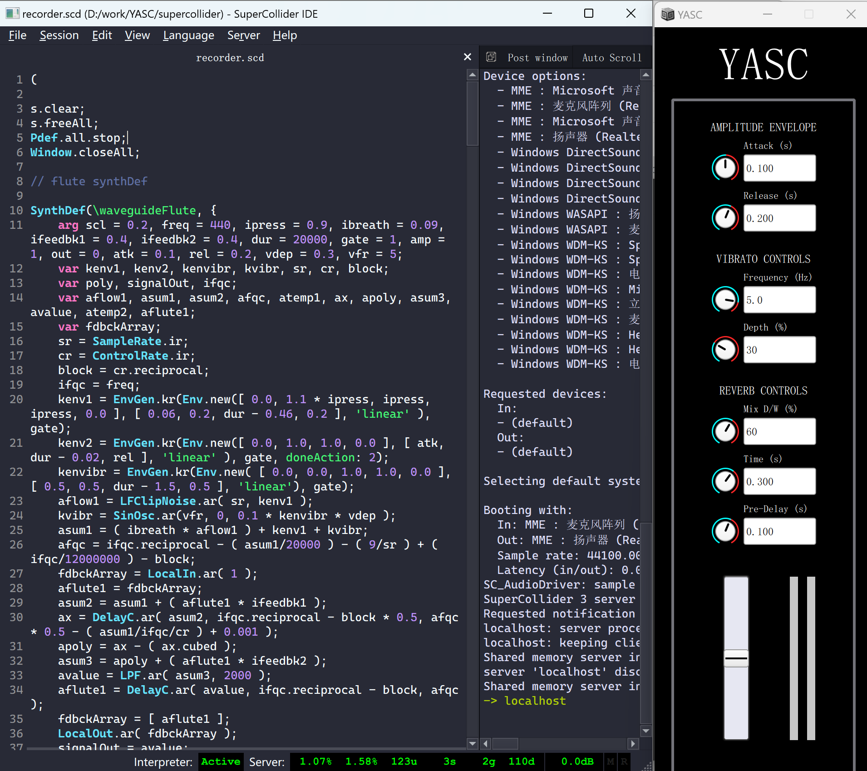
SuperCollider
It's an engine for sound synthesis and algorithmic music composition.
It's a real-time sound-based OOP language

Slide 4
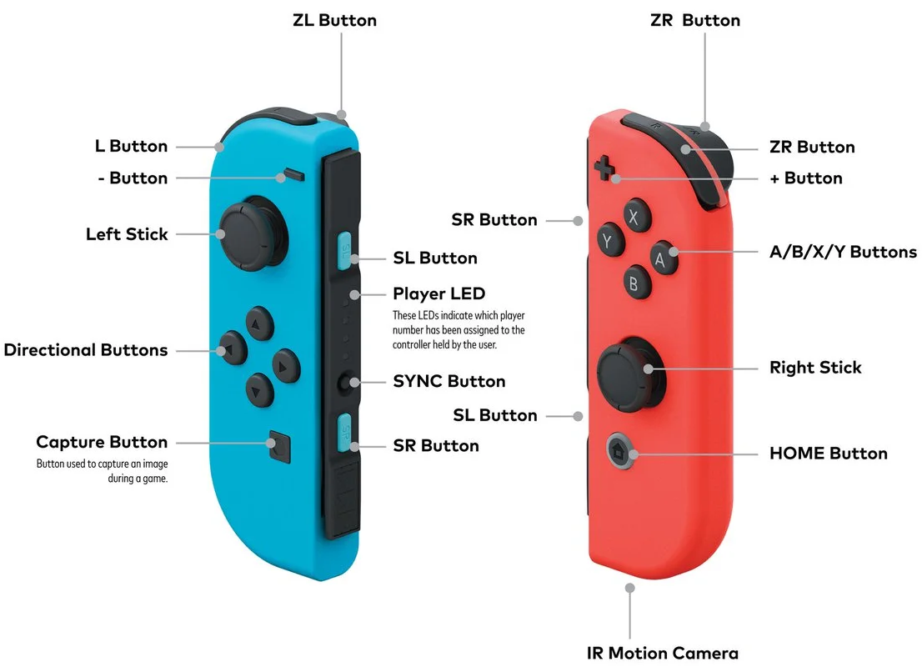
Joy-Con controller
Primary controllers for the Nintendo Switch gaming console
But we could use that to play music

Slide 5
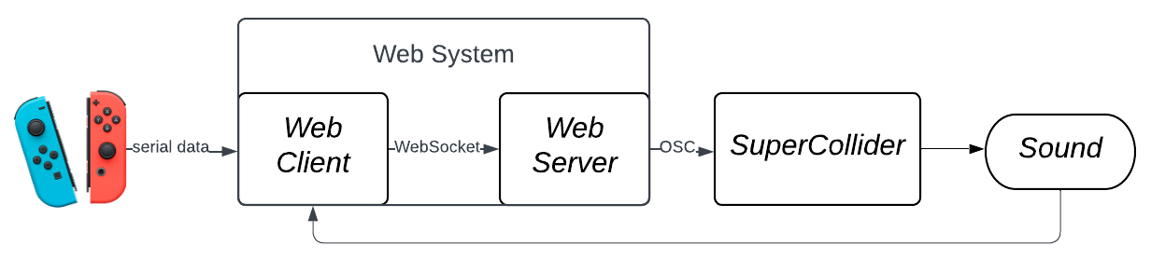
Structure overview
User interaction accomplished with Joy-Con controllers.
Web system acts as main interface.
SuperCollider serves as sound synthesis engine, generating/editing sounds according to the web system commands sent via OSC protocol.
Sound captured by the web system to provide visual feedback.

Slide 6
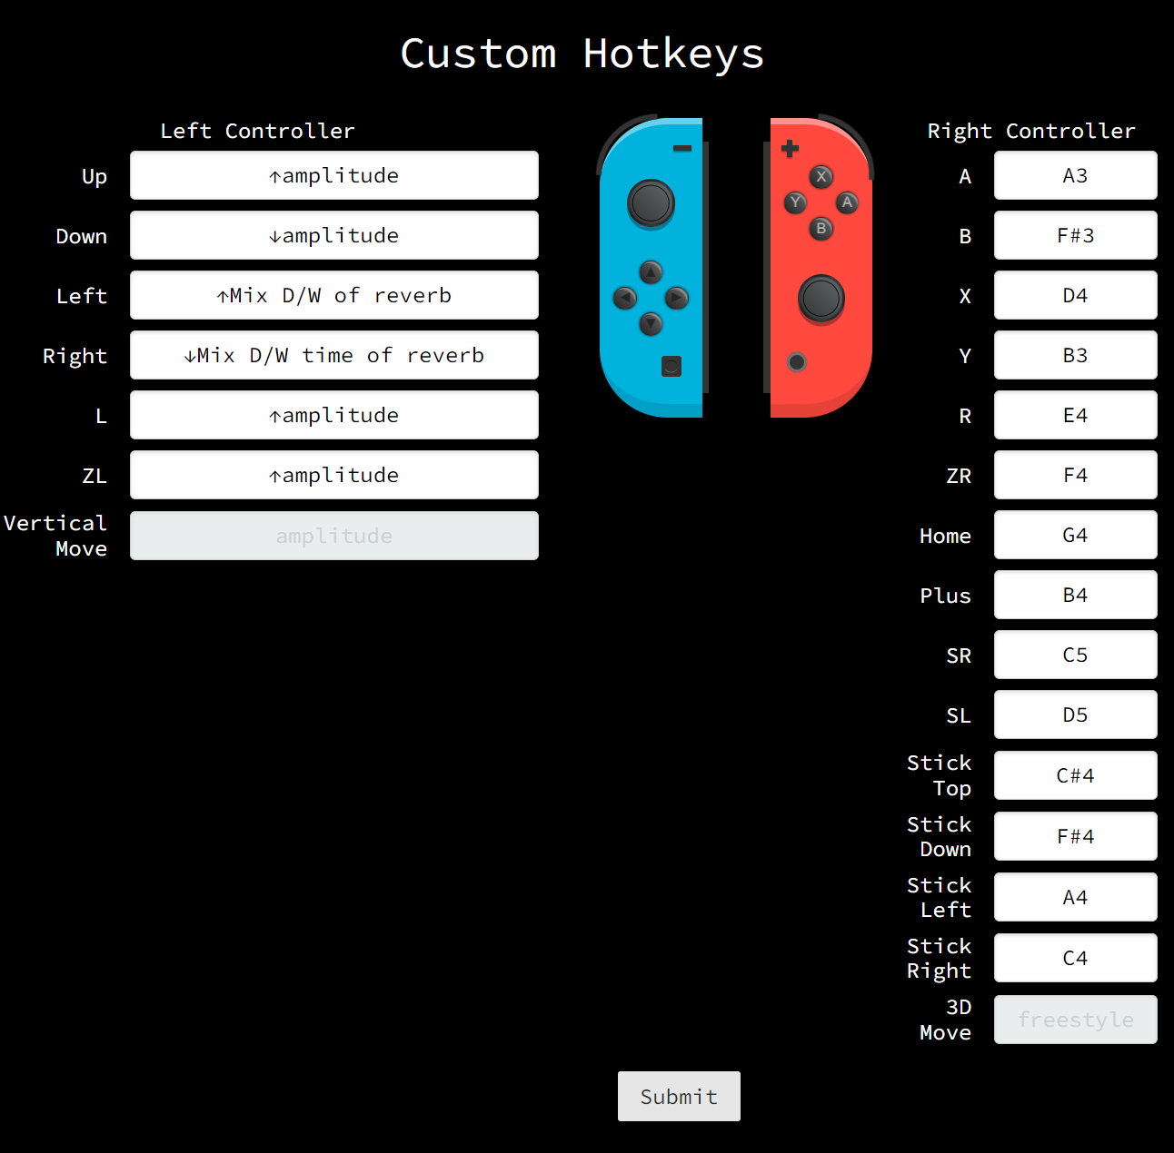
Web system – GUI
Through this page, Joy-Con controller buttons can be mapped to different functions
The left controller is responsible for adjusting synthesis parameters in SuperCollider
The right controller is dedicated to play notes.

Slide 7
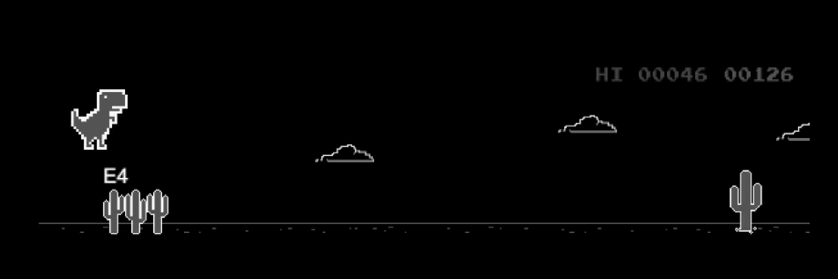
Web system – GUI
The dino game page serves as an interactive training tool designed to help users familiarize with their custom hotkeys

Slide 8
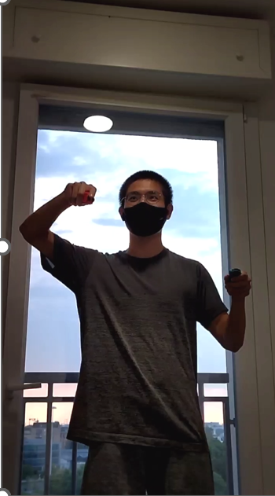
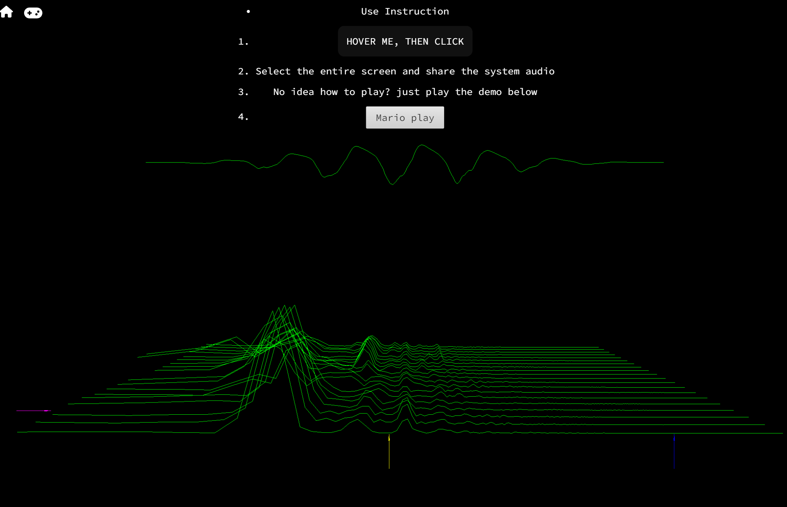
Web system – GUI
The performance page provides an immersive audio-visual experience by representing the output sound spectrum.

Slide 9
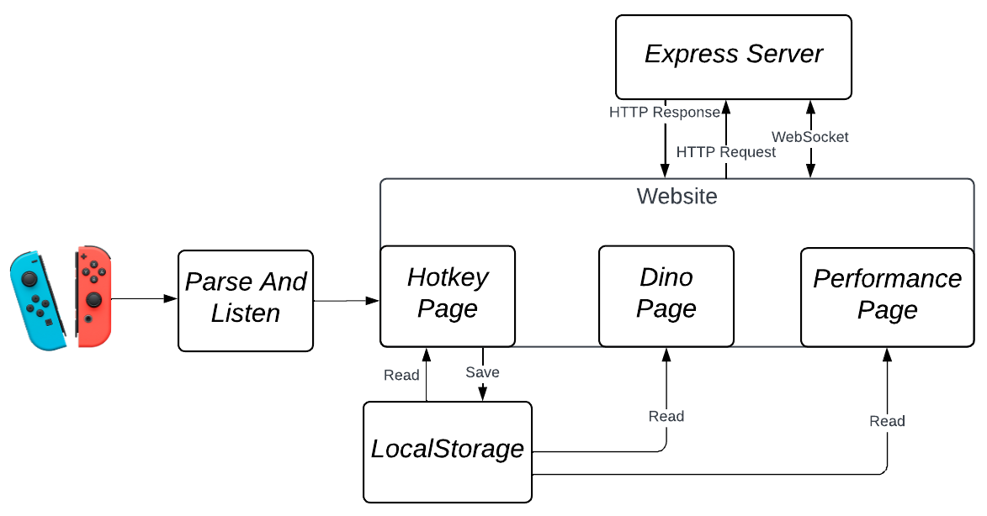
Web system – Implementation
There are three main components which run the web system:

Slide 10
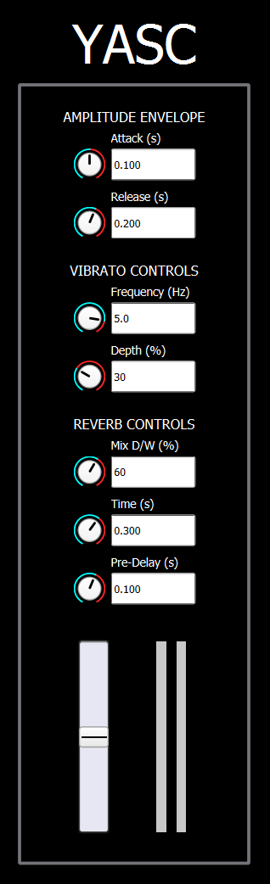
Sound synthesis – GUI
The recorder sound and a simple reverb effect are produced in SuperCollider. The user can see the changes made with controllers of some parameters:
Amplitude envelope attack and release time.
Vibrato frequency and depth.
Reverb D/W mix, time and pre-delay.

Slide 11
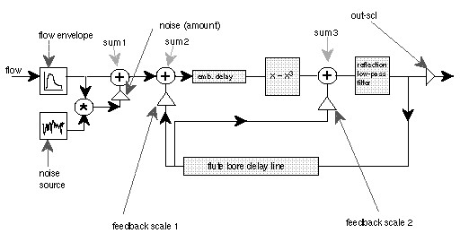
Sound synthesis – Implementation
The recorder model based on Perry Cook’s one with the addition of a LFO to reproduce vibrato.

Slide 12
Thanks

